Slide 1


Python Web apI - Restful
Authentication

Slide 2
User authentication
Normal Django webapp by default using session authentication:
browser send user_name and password when login
------>>>
Server authenticate user and…
return a session id (which should store in cookies)
<<<------
During following every request, browser attach the session id
------>>>
Server check session ID and…
find all user info from session data

Slide 3
User authentication
Another way is to use token for authentication:
browser send user_name and password when login
------>>>
Server authenticate user and…
return a TOKEN
<<<------
Browser can send requestion with optional header contains the token
(it is not limited to one browser. Any browser can use. For example can use laptop and mobile to browse with same token)
------>>>
Server check token and…
find all user info using token.

Slide 4
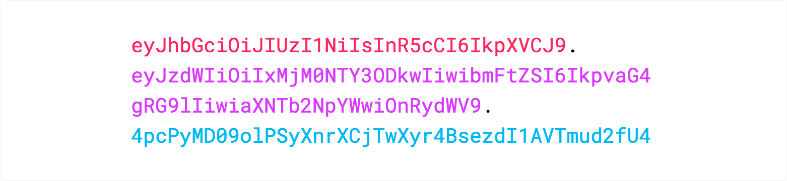
Token format
Today in many case people will use JWT (JSON Web Token)
Header
Payload
Signature
Token format: 3 parts separated by ‘.’
xxxxxxxxxxx.yyyyyyyyyyy.zzzzzzzzzz
A Sample
Header and Payload are public, easily can be decoded.
Signature part is encrypted. Combines [Header+Payload and secret] together and sign it to make sure the integrity.

Slide 5
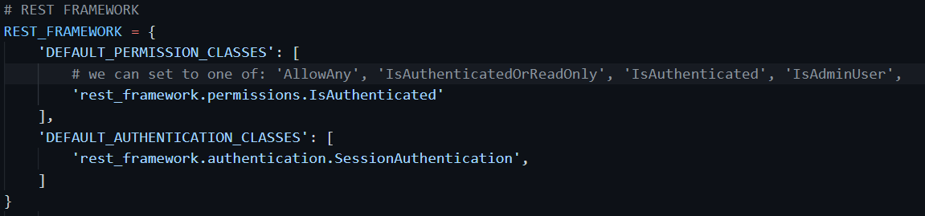
Add authentication in settings.py
Change settings of permission, must be authenticated user
Add authentication class, use session authentication

Slide 6
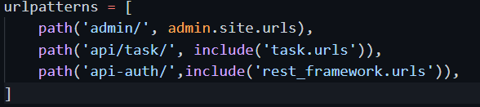
Add the authentication URL
<<<------
New added
It will provide us 2 URL: api-auth/login/, and api-auth/logout/

Slide 7
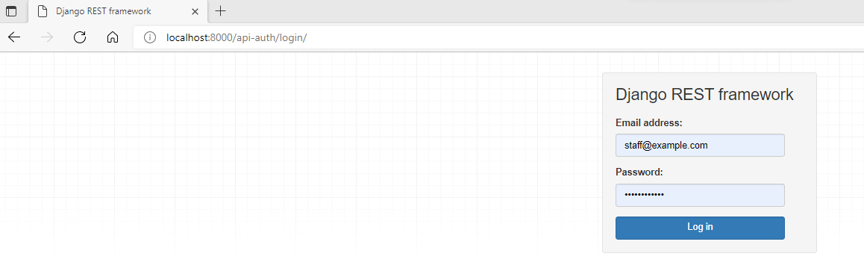
The login web page
We can try the login web page

Slide 8
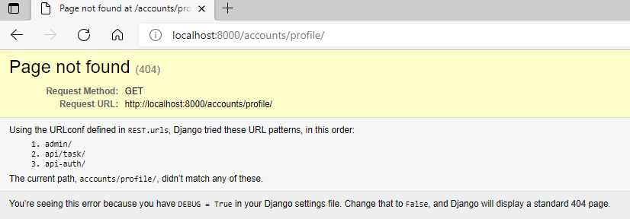
But……
After successful login, it will give us this page not found for /accounts/profile/ webpage.
This is a default redirect webpage after success login.

Slide 9

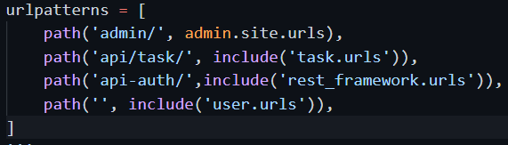
Customize the redirect url
In settings.py, add the redirect url
In project root urls.py, add the include to user.urls

Slide 10


Make the homepage
Define homepage url inside user/urls.py
Use template view, but we are not returning html to user.
We are using JSON, so the HTTP header we need set the content_type. Must include the ResponseMixin.
The template is just a default JSON file. (user/templates/home.json)

Slide 11
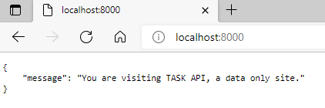
Try again with the browser
After success login with /api-auth/login/, we got this homepage.

Slide 12
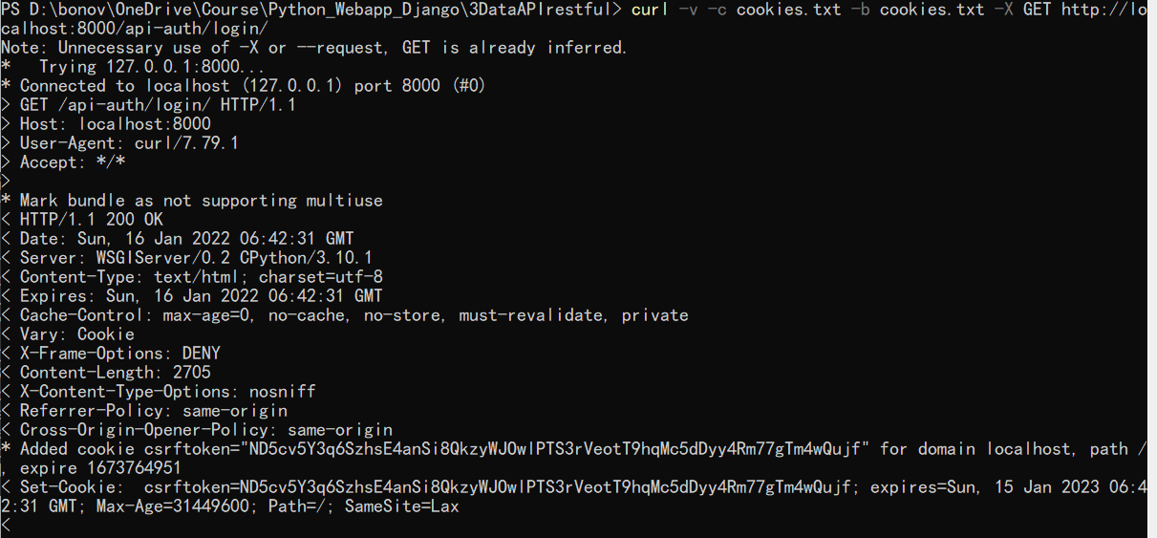
Get the login form
We get a cookie

Slide 13
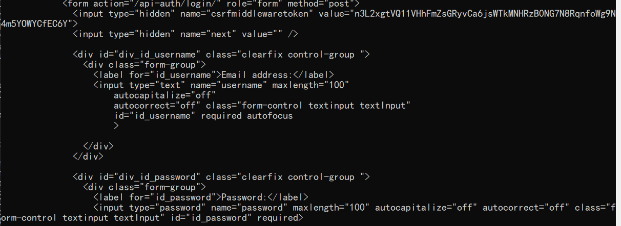
Get the login form
A hidden input token value

Slide 14
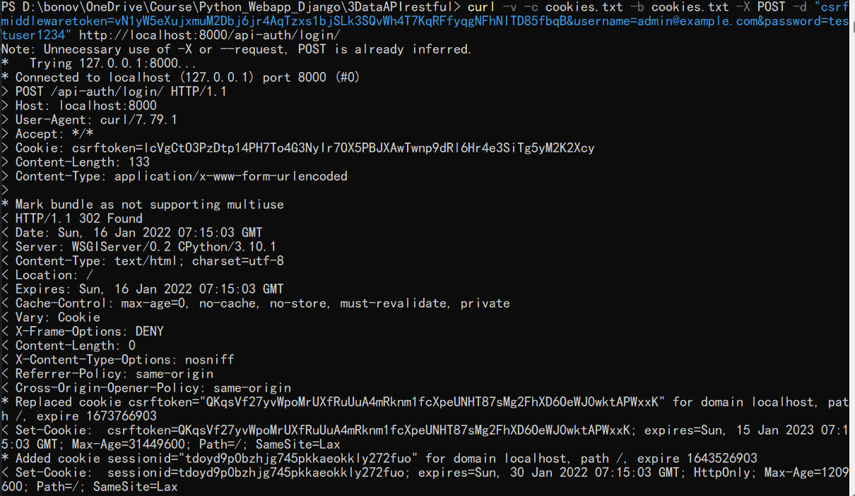
Send the data (like fill form and submit)
All the following request need have this cookie, with sessionid

Slide 15
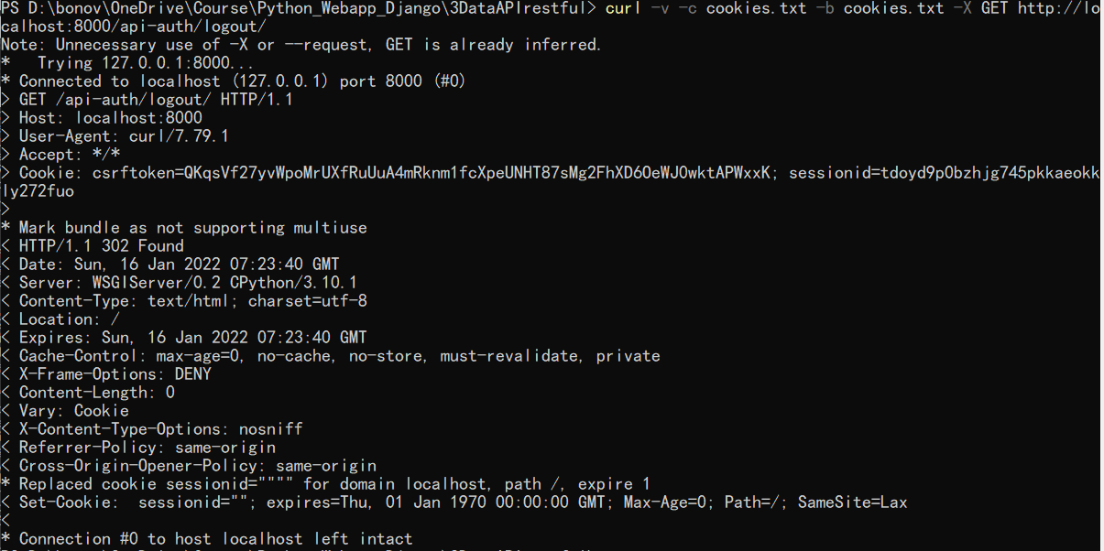
Try the logout
Sessionid was removed from cookie

Slide 16
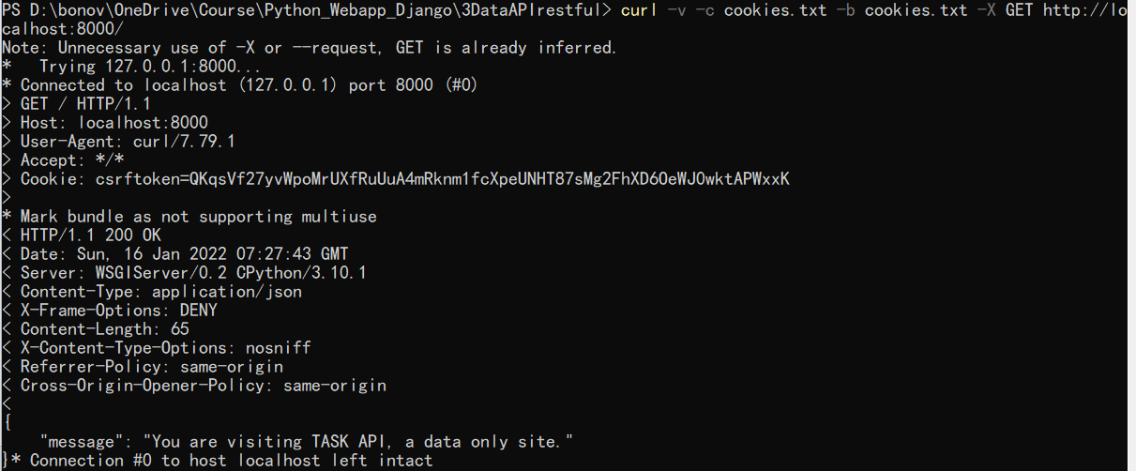
Try the homepage with curl

Slide 17
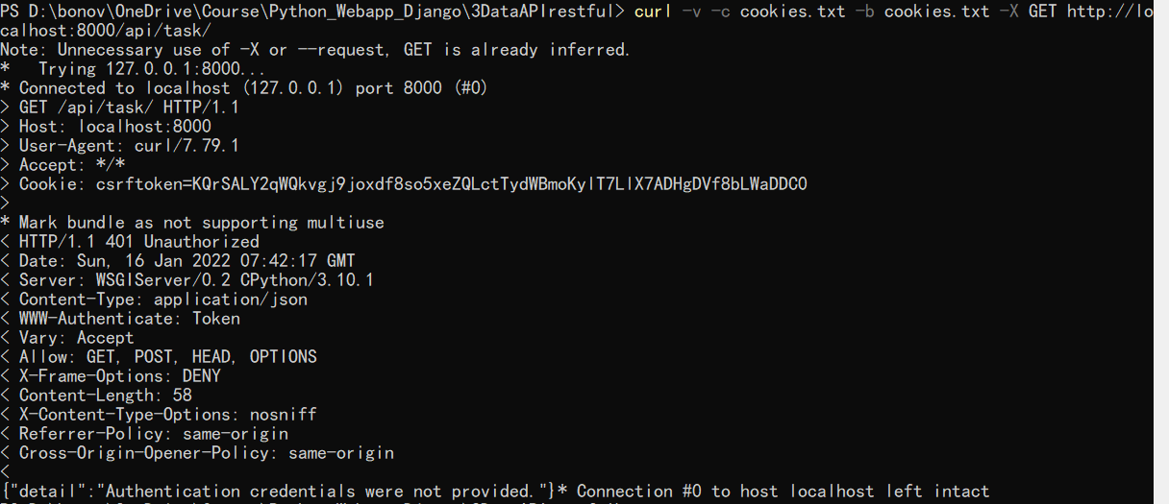
Try to get data when not login

Slide 18
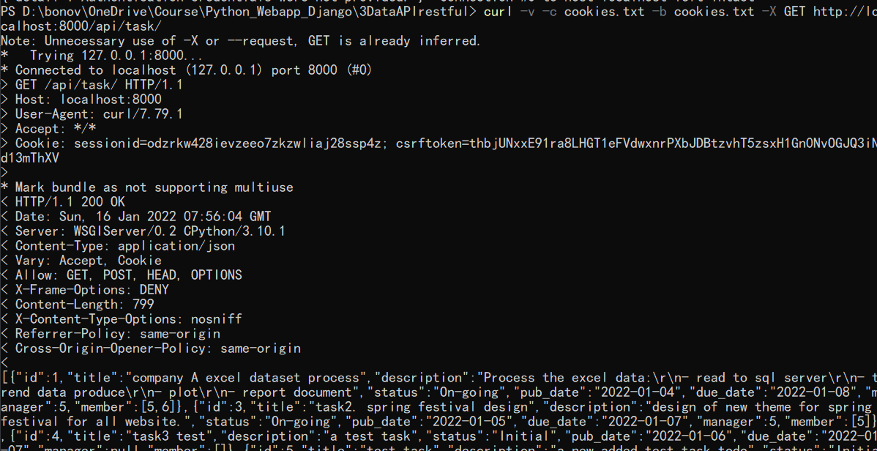
Get data when login

Slide 19
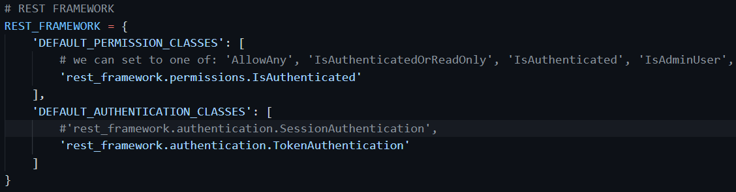
Change to use token authentication

Slide 20
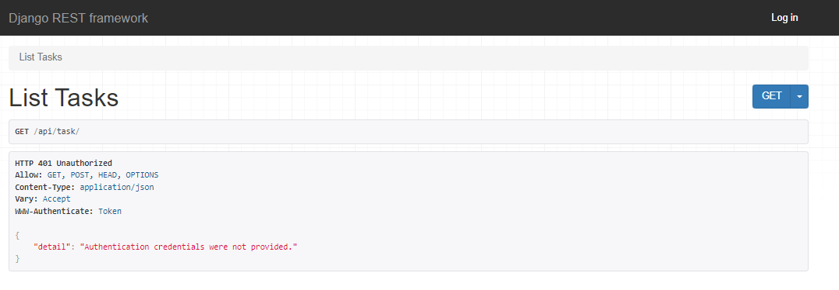
Still can directly visit login and pass the authentication, but cannot use
But cannot do anything due to authentication requested. Cannot even view data.

Slide 21
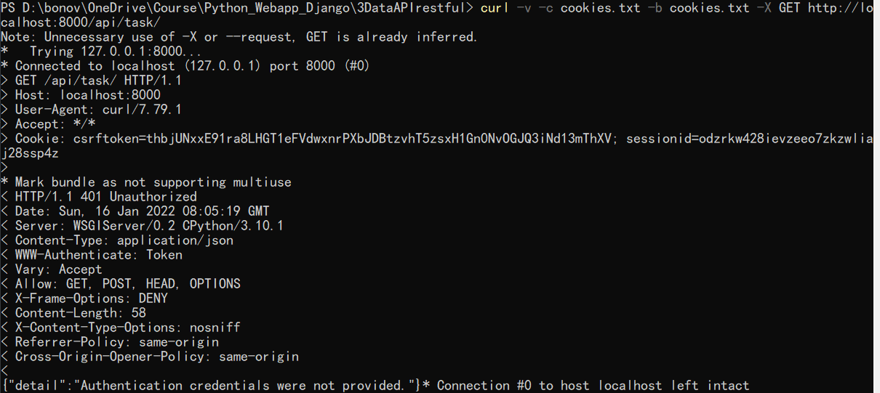
Curl can login and get sessionID. But get data gives error

Slide 22
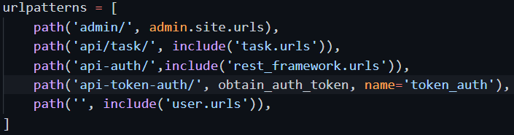
Add a new url to get authentication token
Add new url at project root urls.py.
But if we try, cannot use get to visit and get a form to fill. Must directly use POST to this url.
Or, we can customize a form but let the submit of the form to this url. (the action attribute of form)

Slide 23
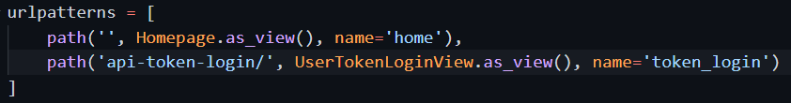

Add the login page for token auth
In the user/urls.py add the login url.
The new view class.

Slide 24
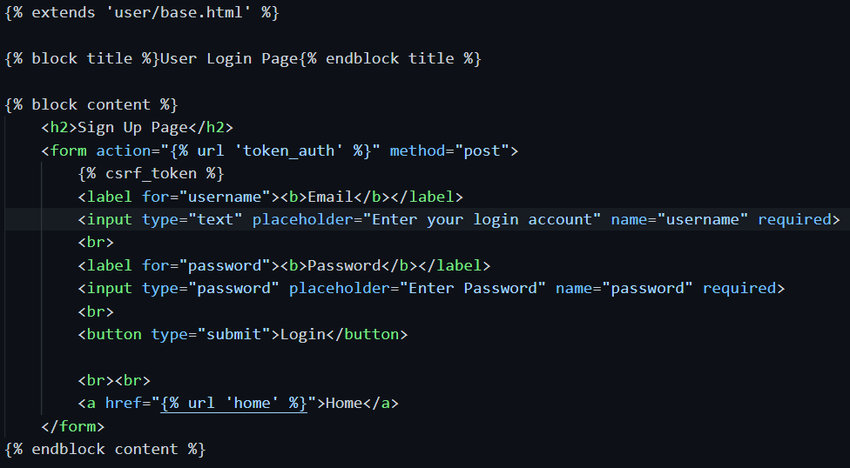
Add the login page for token auth
User/token_login.html template file
The template has the customized form.
The action will make the form data be submitted to obtain_token

Slide 25
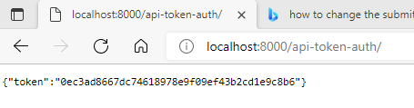
The returned token in browser

Slide 26
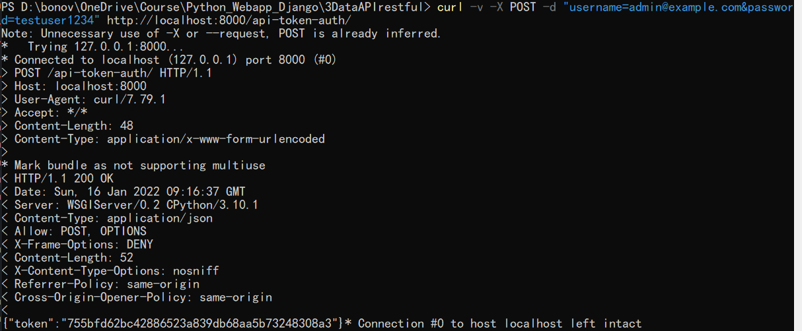
User curl directly send a post to obtain_token

Slide 27
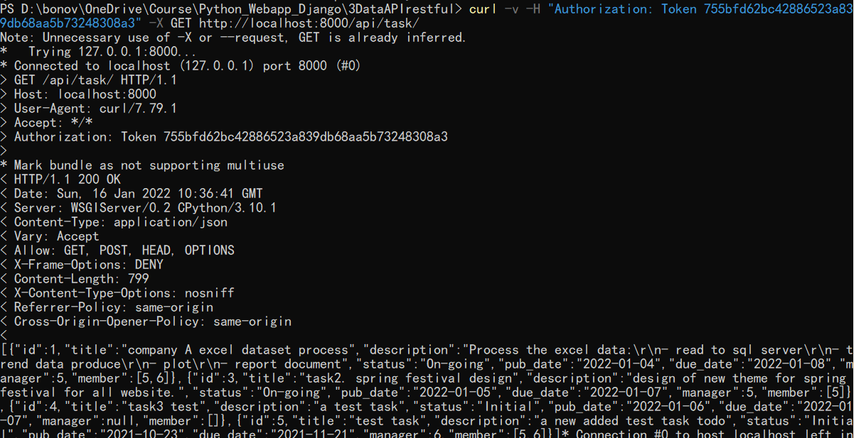
use authentication token at HTTP header

